Slide 1
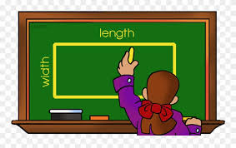
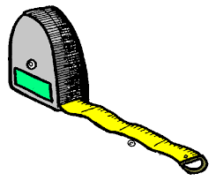
Multiply to Find Area ArEA is the amount of space inside of a given space/object
8 units
Area = 6 x 8
Area = 48 square units
6 Units
When calculating area make sure that your answer is in square units!
Area = Length x Width
Length x Width = Area

